Slide 1
Using the fx-991CW for number and algebra
Task A: Conversions
1) Convert the following times to hours.
a) 1 hour and 15 mins = 1.25
b) 2 hours, 20 mins and 20 secs = 2.338
c) 4 hours, 15 mins and 16 secs = 4.254
.
.
2) Convert the following number of hours to hours, minutes and seconds.
a) 7.25 = 7 hours and 15 minutes
b) 3.7 = 3 hours and 42 minutes
c) 7.42 = 7 hours, 25 minutes and 12 seconds
d) 3.63 = 3 hours, 37 minutes and 48 seconds
3) Fill in the gaps.
a) 121 = 11²
b) 5500 = 2 ² × 5 ³ × 11
c) 384 = 2 ⁷ × 3 ¹
d) 351 = 3 ³ × ? ? × 13
The value represented by the question marks should equal 1.
This can be done by having a base of 1 and any exponent or by having any base and an exponent of 0.

Slide 2

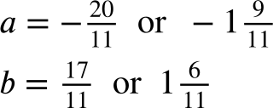
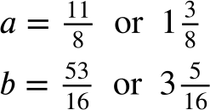
Using the fx-991CW for number and algebra
Task B: Solving linear equations
1) Solve the following without using a calculator and then check your answers using the calculator.
Which way of solving is faster?
a) b) c)
x = 36
x = 2
y = −3.47058…
2) Solve the following pairs of simultaneous equations using your calculator.
a) b)
2a + 3b = 1
2b + a = 8
−a + 4b = 8
2b + 3 = 7a

Slide 3

Using the fx-991CW for number and algebra
Task C: Solving polynomials
1) Solve these quadratic inequalities (to 2 d.p. if appropriate).
a) −x² − 8x + 20 ≥ 0 −10 ≤ x ≤ 2
b) x² + 8x − 19 < 0 −9.92 < x < 1.92
c) x² + 6x + 8 < 3 −5 < x < −1
d) 5x² − x + 5 > 3x² − 10x − 2
Mathematics in Education and Industry
v2.5

